Slide 1
Shell Bootcamp 2024 3 Reflections for Week 2
Anant Bhartiya
Date : 06-Sep-2024

Slide 2

About Me
Exploring the world, embracing new challenges – my journey never stops

Slide 3

My learnings from this week!

Slide 4
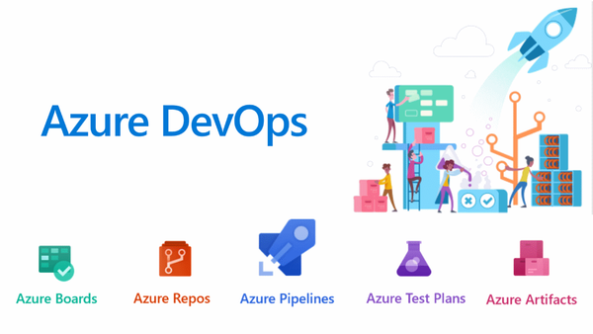
Learning 1 | My takeaways
Azure DevOps
Key learning: Azure DevOps is a comprehensive suite of development tools provided by Microsoft to support the entire software development lifecycle.
Key takeaway: It integrates with various tools and services, enabling seamless collaboration, continuous integration, and continuous delivery (CI/CD).
Azure DevOps can streamline project management and development processes for energy companies, ensuring efficient deployment of software solutions for energy management, monitoring, and optimization.

Slide 5
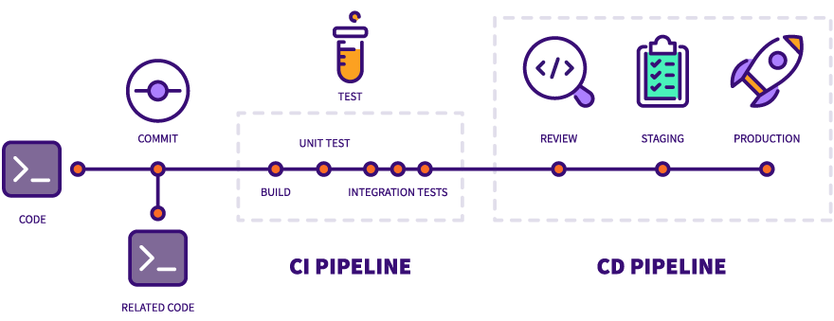
Learning 2 | My takeaways
CI/CD using GitHub Actions and Workflows
Key learning: GitHub Actions and Workflows enable automation of the software development lifecycle, from code integration to deployment.
Key takeaway: GitHub Actions and Workflows enable automation of the software development lifecycle, from code integration to deployment.
Energy companies can use GitHub Actions to automate the deployment of updates to energy management systems, ensuring minimal downtime and rapid response to changing energy demands.

Slide 6
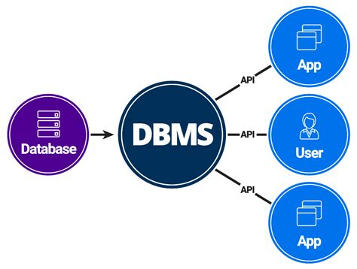
Learning 3 | My takeaways
DBMS (Database Management Systems)
Key learning: DBMS are software systems that use a standard method to store and organize data, making it easily accessible and manageable.
Key takeaway: They ensure data integrity, security, and efficient data retrieval, which are critical for managing large volumes of data.
DBMS can be used to manage vast amounts of data generated by energy production and consumption, enabling better decision-making and optimization of energy resources.

Slide 7

Relevance of learnings for my organization

Slide 8
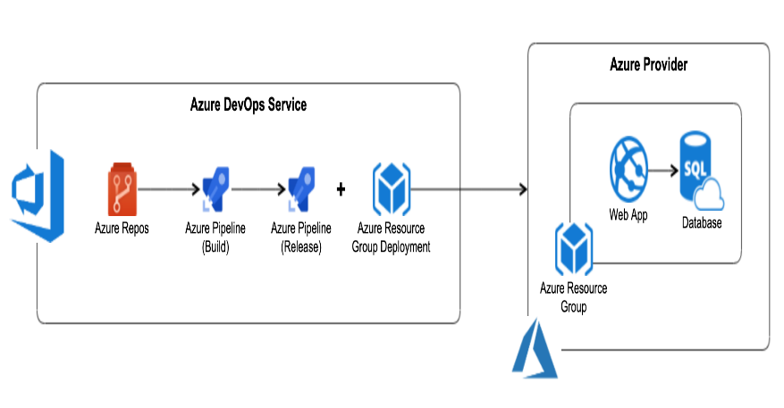
Learning 1 | Relevance for Shell
Shell likely uses Azure DevOps to manage its software development projects, integrating various tools and services to ensure seamless collaboration among development teams. This includes using Azure Boards for project tracking, Azure Repos for source control, and Azure Pipelines for CI/CD.
By implementing Azure DevOps, Shell can achieve more efficient project management and faster deployment of software solutions. This leads to improved energy management, monitoring, and optimization, ultimately enhancing operational efficiency and reducing costs.
This Photo by Unknown Author is licensed under CC BY-NC

Slide 9

Learning 2 | Relevance for Shell
Shell probably leverages GitHub Actions and Workflows to automate its CI/CD pipelines. This includes automating code integration, testing, and deployment processes to ensure that updates to energy management systems are deployed quickly and reliably.
Using GitHub Actions and Workflows, Shell can minimize downtime and respond rapidly to changing energy demands. This automation enhances the speed and reliability of software releases, ensuring that energy management systems are always up-to-date and functioning optimally.

Slide 10
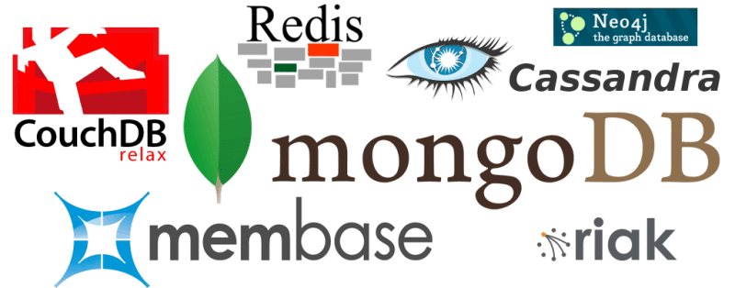
Learning 3 | Relevance for Shell
Shell likely uses advanced DBMS to manage the vast amounts of data generated by its energy production and consumption activities. This includes using relational databases for structured data and NoSQL databases for unstructured data.
By implementing robust DBMS, Shell can ensure data integrity, security, and efficient data retrieval. This enables better decision-making and optimization of energy resources, leading to more effective energy management and improved operational performance.
This Photo by Unknown Author is licensed under CC BY-SA-NC

Slide 11

Challenges in implementing learning

Slide 12
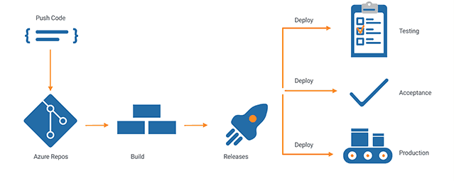
Challenge faced while implementing Learning 1
Challenges: Grasping how to integrate Azure DevOps with various tools and services can be overwhelming due to the complexity and variety of options available.
How to Overcome: Start with basic integrations and gradually move to more complex ones. Utilize online tutorials, documentation, and community forums for guidance.

Slide 13
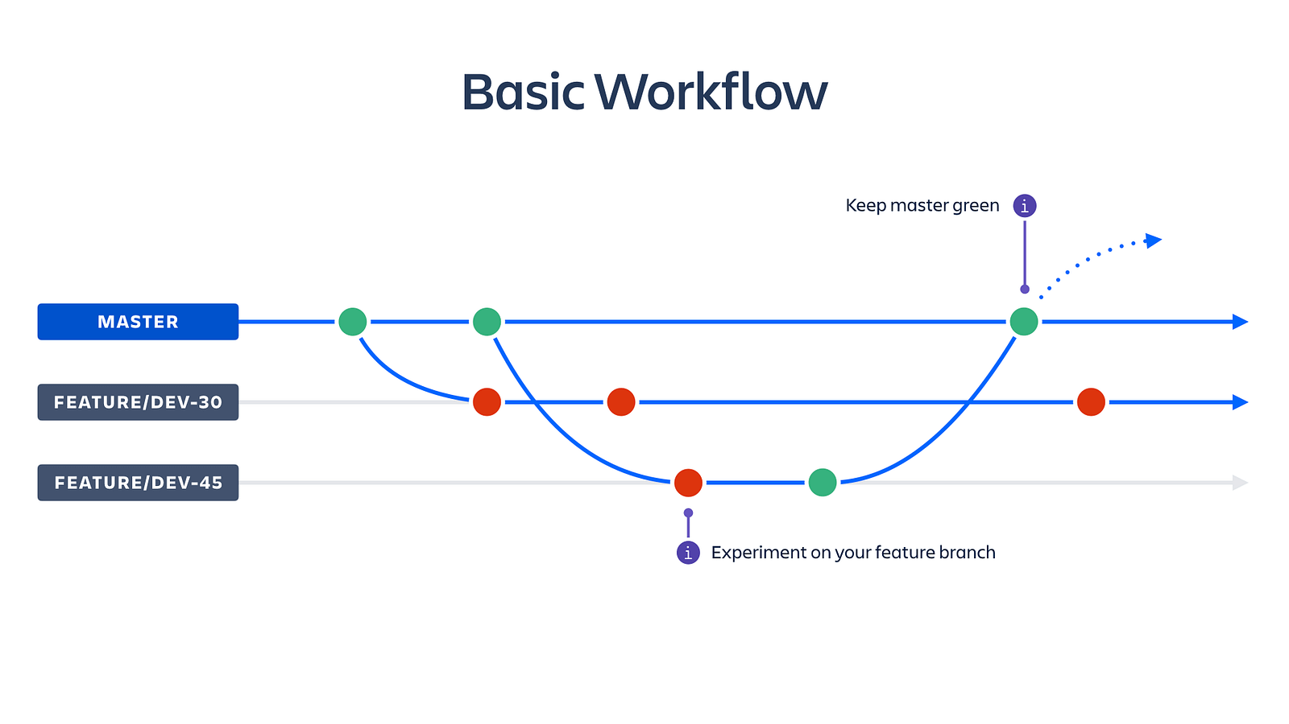
Challenge faced while implementing Learning 2
Challenges: Setting up and configuring GitHub Actions and Workflows can be challenging, especially when you’re new to CI/CD concepts and the syntax used in workflows.
How to Overcome: Begin with pre-built templates and examples available in the GitHub Actions marketplace. Study and modify them to understand how they work, and gradually build your own workflows as you gain confidence.
This Photo by Unknown Author is licensed under CC BY

Slide 14
Challenge faced while implementing Learning 3
Challenges: Learning to manage and optimize databases can be difficult due to the vast amount of information and techniques involved in DBMS.
How to Overcome: Engage in hands-on projects and exercises to apply what you’ve learned. Use online resources, courses, and practice scenarios to build your skills.

Slide 15

Action Plan

Slide 16
My Action Plan for this Week
Actions
Timeline
Status
Get to know the tools used by my team
Engage in Conversations with my Team members
Review some of the basic concepts that might be useful
Day 1: Attend Changemakers of Tomorrow
Day 2&3: Figure out the tools used by the team.
Day 4: Get to know some of my team members.
Day 5: Review basics.
Connected with my buddy and the VM team.
Actively participated in foundation training.

Slide 17

Learning is also Fun!

Slide 18
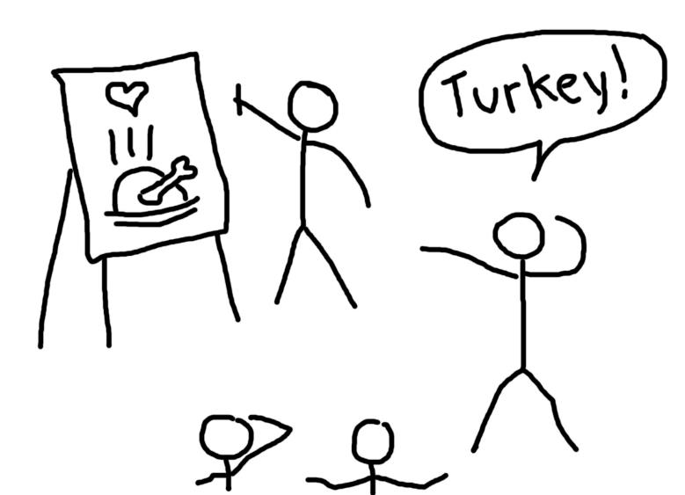
Learning is also Fun!
Our instructor made learning enjoyable by incorporating games into our sessions. One memorable activity was a drawing game where we had to draw on each other’s backs and pass it along until the final person drew it on paper. This led to some hilarious results and helped us bond as a team.
A simple drawing turned into an abstract piece of art by the end, highlighting the importance of clear communication.

Slide 19

Summary
This week, we focused on Azure DevOps, CI/CD with GitHub Actions, and DBMS. We learned how these tools to streamline development and data management, and participated in fun activities like to enhance teamwork.
Next week, we will participate in custom bootcamps with a focus on the specific tools and techniques used in our departments. This targeted training is essential to equip us with the necessary skills to seamlessly integrate into our respective teams.
The basics learned this week are essential for understanding next week’s topics. Hands-on practice and team interactions have provided a solid foundation for further learning.

Slide 20
Thank You

